Slide 1



Concurrent programming in python
An introduction to multi-threading, multi-processing and event loops
James R. Small
Notes:
A little about me – I’ve worked full time in IT since ’95. My first scripting language was shell scripting in UNIX, specifically using the C-shell in SunOS 4, a BSD derivative. For the last couple of years, I’ve been playing with Python, so this talk will use that for the examples.

Slide 2


Why concurrency?
Performance, Responsiveness
Why not just a faster processor/ computer?
Moore’s Law
See: Packet Pushers Show 315: Future Of Networking – Pradeep Sindhu
Notes:
Faster is usually better.
Why not? The days of faster CPUs are over. Performance gains are now from parallelization utilizing multiple cores.
Moore’s law is at an end – from the limits of heat dissipation and power to quantum effects from minute sizes
This isn’t just true for CPUs, also impacts networking and I/O in general
Highly recommend this podcast episode for a deep dive into the limits of CPUs, I/O and Networking
Time: ?

Slide 3
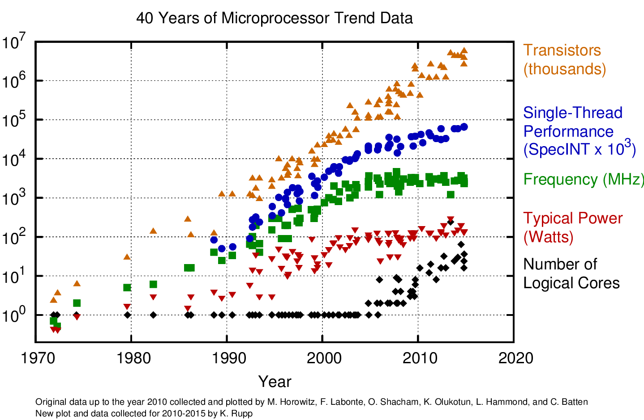
necessity of concurrency
Notes:
Notice that clock speed or frequency hasn’t increased in years, only the number of cores is increasing
Time: ?

Slide 4
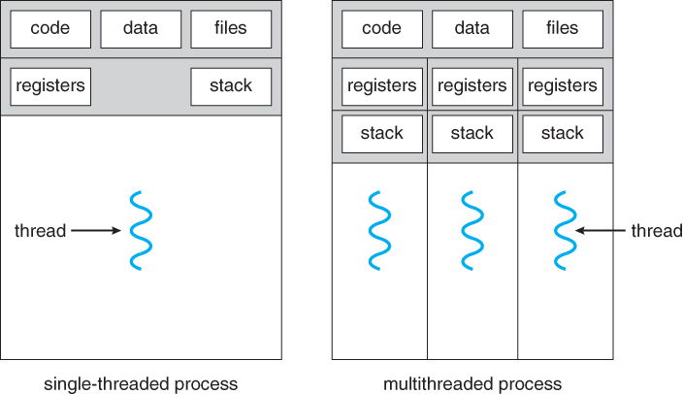
Basics – Running a Program
Process – essentially a container which hosts an executing binary or program
Thread – what actually runs (the) code within a process, all processes have at least one thread; each thread is a separate “flow” of execution
Notes:
Run process explorer and show processes and threads
Show python interpreter in process explorer
Time ?

Slide 5

Basics – Scaling Performance, limiters
Should I always try to leverage multiple cores?
Problem Type
CPU-Bound – Program completion determined by speed of the central processor
I/O-Bound – Program completion determined by time spent waiting for (external) input/output operations to finish
Notes:
Understand the type of problem
Time ?

Slide 6

Basics – Scaling Performance, Terms
Concurrency – when two or more tasks can start, run, and complete in overlapping time periods. It doesn't necessarily mean they'll ever both be running at the same instant. E.g., multitasking on a single-core machine. (StackOverflow)
Parallelization – when tasks literally run at the same time, e.g., on a multi-core machine. (StackOverflow)
Notes:
Note that this distinction is particularly important for scripting languages as we’ll see shortly
Time ?

Slide 7
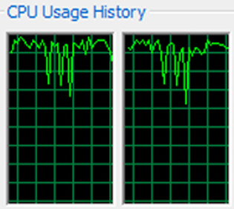
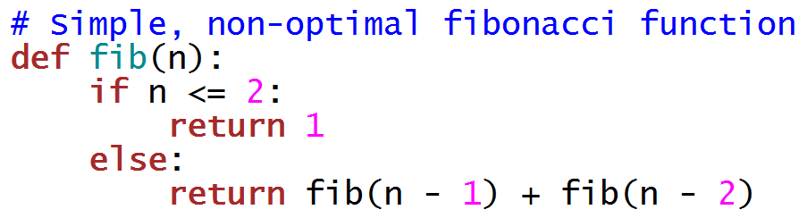
Example – Calculate Fibonacci number
CPU-Bound Problem
Example Implementation:
Notes:
Using fib.py (python3 –i fib.py)
Demo calculating Fibonacci number for 1, 10, 20, 30, 35, 36
Time ?

Slide 8
Basics – Differences
Process – has its own address space (not shared with other processes)
Heavier weight, slower to instantiate
Independent state (safer)
Collaboration requires IPC
Thread – shared address space with hosting process
Lighter weight, faster to instantiate
Shared state (must protect against corruption)
Native collaboration (shared state)
Notes:
Time ?

Slide 9
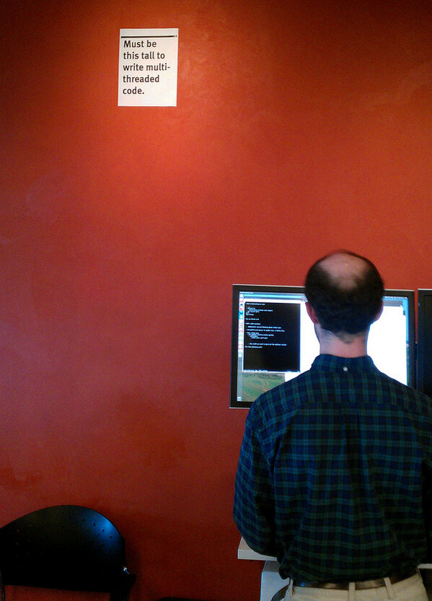

respect for concurrent programming
Notes:
At Mozilla, as with most companies, there's a hierarchy of engineers - junior engineer, senior engineer, etc. The highest level, distinguished engineer, has only been achieved by four people. One of those, David Baron, who works out of Mozilla's San Francisco Office, has a sign next to his cubicle. Although David is tall at well over six feet, the sign towers over him. The sign reads, "Must be this tall to write multi-threaded code.“
Concurrency and threading are problems that can be solved but respect or a healthy fear is important!
Time ?

Slide 10

question – which will be faster?
In Python, which technique will be faster for (concurrently) solving a list of Fibonacci numbers?
Multi-threading
Multi-processing
Why?
Notes:
Demo both to show – each one calculates four 36th Fibonacci numbers concurrently
python3 -i multithrfib.py
* And show in process explorer
python3 -i multiprocfib.py
* And show in process explorer
Why? Remember that threads have shared state. How can a scripting language protect its mutable state with multiple threads having concurrent access to its internal data structures? Answer – by using a lock which only allows a single thread to execute at a time. So threads can run concurrently but not in parallel. Processes don’t have this limitation – each new process is an independent copy of the old one. This means each new process is a new instance of python or whatever the scripting language is. The benefit is processes can run in parallel. The drawbacks are processes are much more heavy weight – each one is a full instance of the scripting language! In addition, since processes don’t share state, you need some kind of IPC to communicate between them. Python tries to hide this by semi-automatically passing data back and forth, but you may notice that it does this through pickle. Just like transmitting data over the network, to transmit data between processes you must serialize and deserialize it (hence the use of pickle). In python, this master lock is called the GIL or Global Interpreter Lock. While this seems to be controversial in python, from what I can see, all scripting languages appear to have this limitation. This is definitely true for Ruby, Perl, JavaScript/Node, PHP and R and I’m virtually certain it’s also true for PowerShell.
Time ?

Slide 11
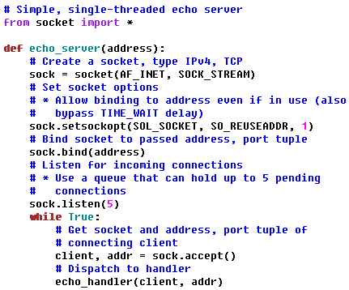
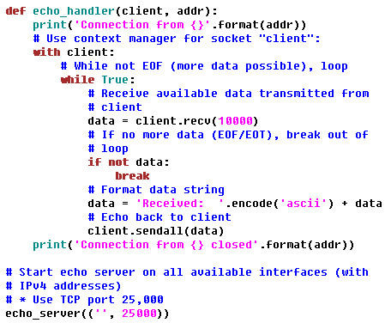
building example server
Remaining examples will be I/O-Bound (network based)
Will use simple echo server to demonstrate concurrency approaches
Notes:
Start app: python3 -i singlethrechosrv.py
Time ?

Slide 12
building example server
What’s wrong with this example echo server?
More definitions:
Blocking – a call that doesn’t immediately return (you have to wait for it)
Non-blocking – call immediately returns
Notes:
Try two connections to this server to show blocking problem
Time ?

Slide 13

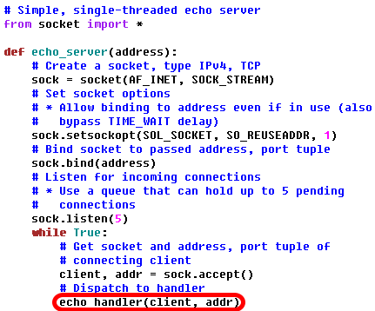
problem with example server
When highlighted section of code runs, the server is “blocked” until the client (echo_handler) finishes:
Notes:
Time ?

Slide 14
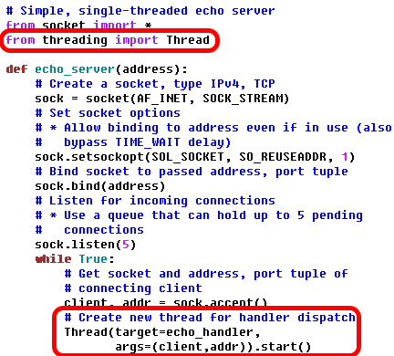

Option 1 – Use Multi-threading
Use a new thread to service each incoming client. Frees up server so it’s non-blocking:
Good for
I/O-Bound
Problems
Notes:
Run server: python3 -i multithrechosrv.py
Time ?

Slide 15
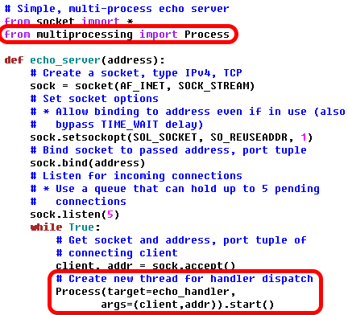


Option 2 – Use Multi-processing
Use a new process to service each incoming client. Frees up server so it’s non-blocking:
Good for
CPU-Bound
Problems
Notes:
Run server: python3 -i multiprocechosrv.py
Time ?

Slide 16
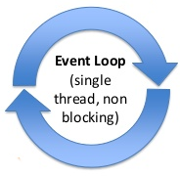
Option 3 – Use an event loop
In addition to processes and threads, there’s another paradigm – an event loop.
Why not stick with processes/threads?
Scale – processes/threads good into thousands, what if tens of thousands (or more) of concurrent connections need to be serviced?
Notes:
Time ?

Slide 17
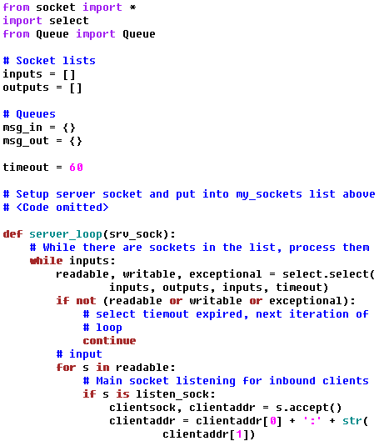
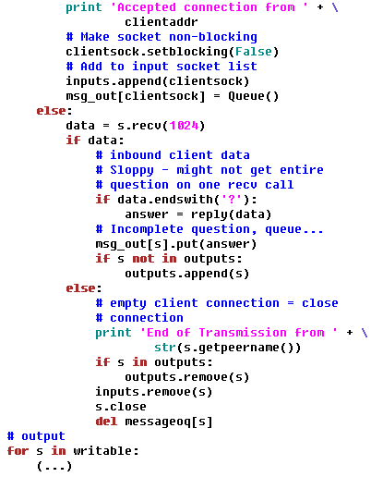
event loops – based on select (example)
Notes:
Time ?

Slide 18

select limitations
Select scales to monitoring dozens of sockets (file descriptors, handles, ...)
For scalable implementation, it’s platform dependent:
Linux – epoll
OS X/MacOS/BSD – kqueue
Windows – iocp
Painful – solution, Python’s asyncio abstracts all this away!
Notes:
Time ?

Slide 19
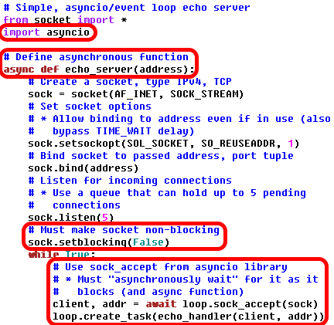
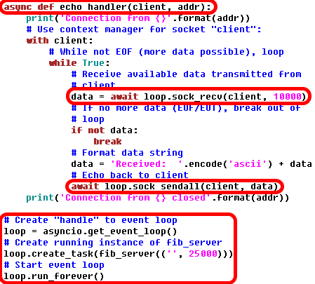
Option 3 – event loop using asyncio
Use a new process to service each incoming client. Frees up server so it’s non-blocking:
Notes:
Run: python3 -i asyncechosrv.py
Using an event loop
Start the event loop
Register events with callback functions – in this case we’re creating a task with is a coroutine wrapper for a future
future means that coroutine has something that will block
coroutine is essentially a stateful function that can be suspended and resumed while retaining its state
unlike pre-emptive multitasking model, event loops and coroutines use cooperative multitasking – coroutine chooses where to yield with await keyword; this returns control to the event loop which then monitors this blocking “I/O Channel”; once the channel is ready (client connects), coroutine is scheduled to run by event loop; when coroutine runs it resumes where it suspended; blocking call is now ready and function proceeds like nothing happened
But – must be careful not to block event loop! Everything should be non-blocking and loop grinds to a halt...
Time ?

Slide 20
examining event loops and async
Event Loops work well when waiting for lots of I/O
networking
GUI
Popular Uses:
web browsers
GUI/graphics toolkits
highly scalable web servers (nginx)
chat applications
Notes:
For first bullet:
* Especially true if I/O is slow and/or unpredictable (e.g., networking)
* Efficient at waiting for large number of I/O operations (read/write/exception for sockets)
Important note – for asyncio with async/await must run Python version >= 3.5, 3.5.0 came out September of 2015, 3.5.2 came out June of 2016, 3.6.0 came out December 23rd of last year – only a few weeks ago!
Time ?

Slide 21
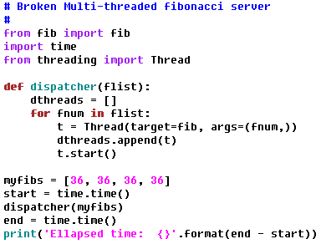
A few more words
Multi-Threading Caveats – What’s Wrong?
Notes:
Time ?

Slide 22
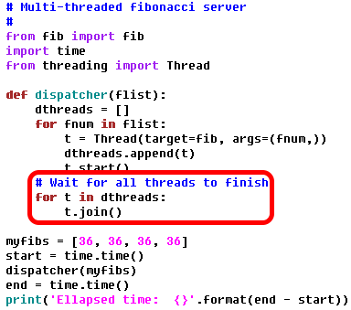
A few more words
Multi-Threading Caveats – Fixed:
Notes:
Time ?

Slide 23
Great resources
Raymond Hettinger's Thinking about Concurrency Talk
Raymond is a core Python developer
He wrote many of the standard libraries
Learn from the master
Notes from his talk
Philip Roberts: What the heck is the event loop anyway? | JSConf EU 2014
A Web Crawler With asyncio Coroutines by A. Jesse Jiryu Davis and Guido van Rossum
Notes:
Time ?

Slide 24




Questions
?
@sockduct
github.com/sockduct
Notes:
Time: ?
Take questions if time

Slide 25
Additional resources used
Common asynchronous patterns in Python - PyOhion 2016
Fear and Awaiting in Async - Beazley, PyOhio 2016 Keynote
Shahriar Tajbakhsh - Parallelism Shootout: threads vs asyncio vs multiple processes
Tulip: Async I/O for Python 3 by Guido van Rossum at Twitter
Guido van Rossum on Tulip (January 2014)
A. Jesse Jiryu Davis: What Is Async, How Does It Work, And When Should I Use It? - PyCon 2014
Keynote David Beazley - Topics of Interest (Python Asyncio)
David Beazley - Python Concurrency From the Ground Up: LIVE! - PyCon 2015
Yury Selivanov - async/await in Python 3.5 and why it is awesome
Understanding the Linux Kernel, 3rd Ed, Chapter 3 - Processes, Lightweight Processes and Threads
Windows Internals, 6th Ed, Chapter 5 - Processes, Threads and Jobs
Code Podcast, Episode 1 – Concurrency, Episode 2 – Concurrency – CSP & Actors, Episode 3 – Concurrency – Event Loop & Coroutines
Software Engineering Radio Podcast, Episode 12 – Concurrent Part 1, Episode 19 – Concurrency Part 2, Episode 29 – Concurrent Part 3
Notes:
Time ?

